Slide 1
Title: Data-Driven Selection of Aircraft
Identifying Low-Risk Aircraft Models for Safe and Profitable Expansion

Slide 2

Project Overview
The aviation industry expansion requires data-driven insights to minimize risks in aircraft selection.
Goal is to identify low-risk aircraft models that ensure safety, efficiency, and regulatory compliance.
I leveraged historical incident and operational data to drive decision-making.

Slide 3

Business Understanding
Objective: To identify the safest and most cost-effective aircraft models for both commercial and private aviation operations.
Key Considerations:
Aircraft safety and historical incident rates.
Operating costs including fuel efficiency and maintenance.
Technological advancements and compliance with safety standards.
Key Questions:
Which aircraft models have the lowest accident rates?
What are the cost implications and operational risks for different aircraft?

Slide 4
Data Understanding
Data Sources:
Aviation safety databases ( National Transportation Safety Board). Historical accident and incident reports. Aircraft performance, weather conditions, and flight phases.
Key Data Columns:
Aircraft Make/Model, Incident Count, Flight Phase, Weather Condition, Casualties (Fatal/Serious Injuries).
Data Challenges:
Missing values in certain columns (weather and location data).
Inconsistent entries for aircraft models.

Slide 5

Data Analysis
Incident Count by Aircraft Make:
Incident Count by Aircraft Make:
Analyzed aircraft models with the fewest recorded incidents.
Phase of Flight Risk:
Incidents more common in critical phases (takeoff, approach, landing).
Weather Conditions:
Aircraft that performed well in adverse weather conditions were favored.

Slide 6
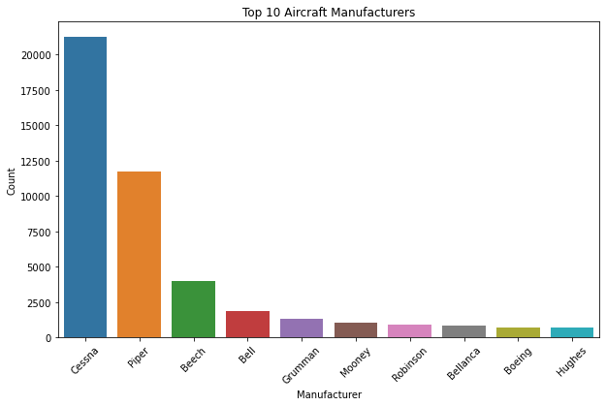
Preview of the Data Analysis

Slide 7
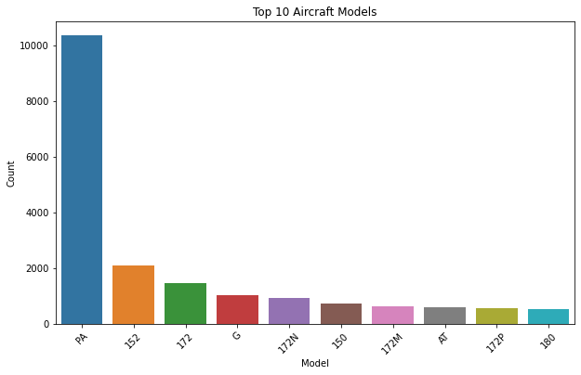
Preview of the Data Analysis

Slide 8
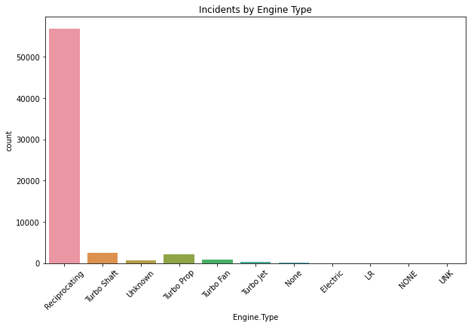
Preview of the Data Analysis

Slide 9

Conclusion
Based on data analysis, the following insights were drawn:
Low-Risk Aircraft: Identified aircraft models with low accident rates and strong safety records.
Weather Resilience: Prioritized models that operate well in challenging weather conditions.
Thus recommend this aircraft based on incident rate and other factors: this aircraft types;- KnaKenDacWel, Menees, Menzimer, Mercer, Merchant since they have the least incident cases and seem to be reliable in this case.
Next Steps: Further assessment and pilot small-scale operations with identified aircraft models to validate real-world performance.

Slide 10

Thank you for your time and attention.

